Slide 1

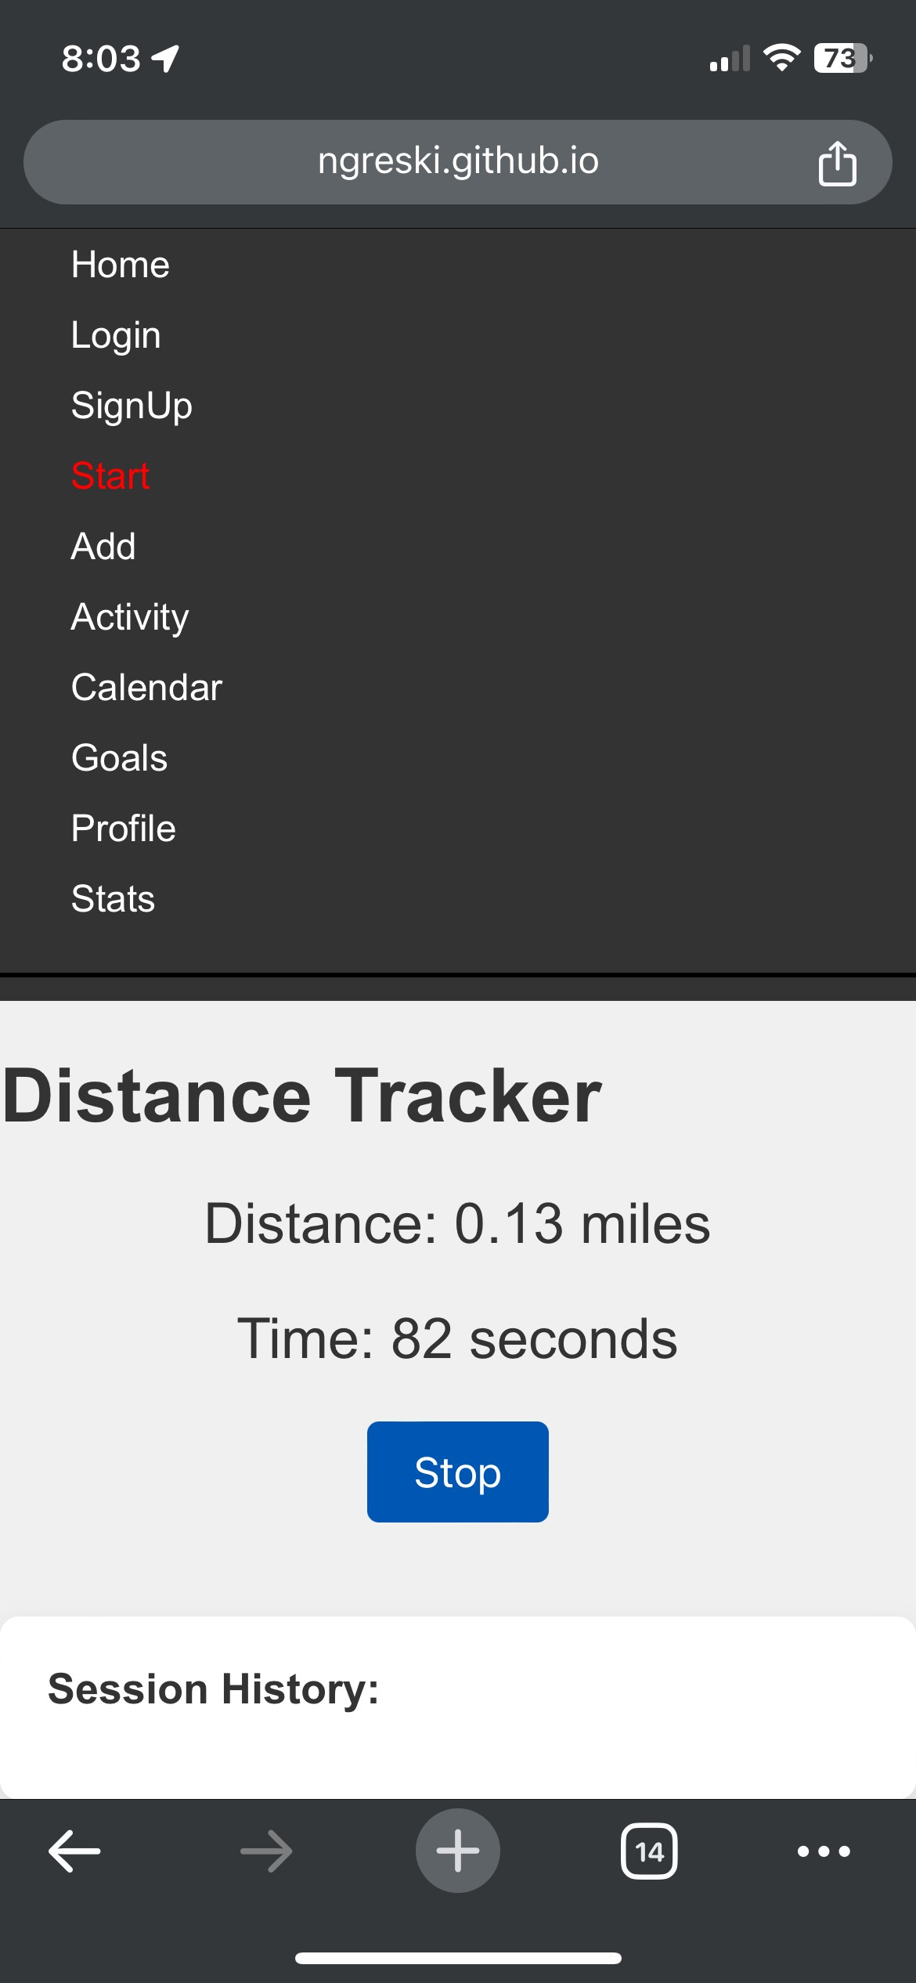
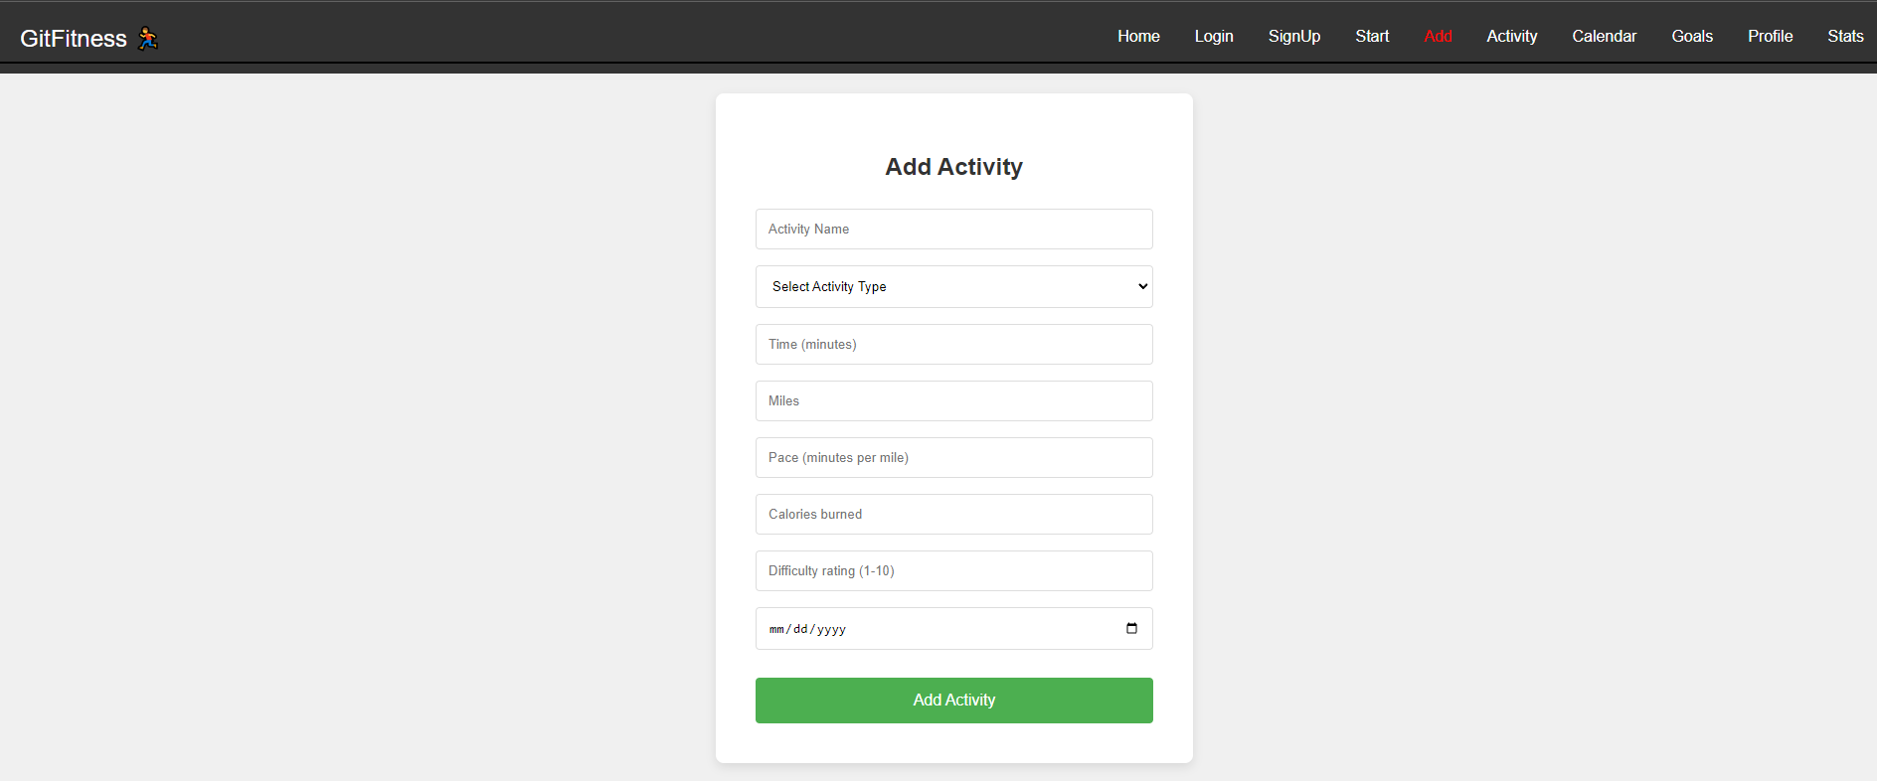
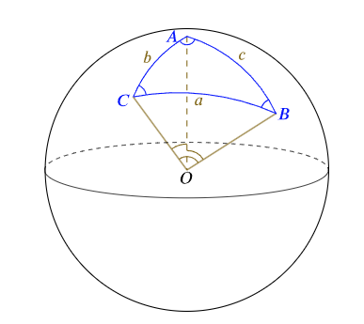
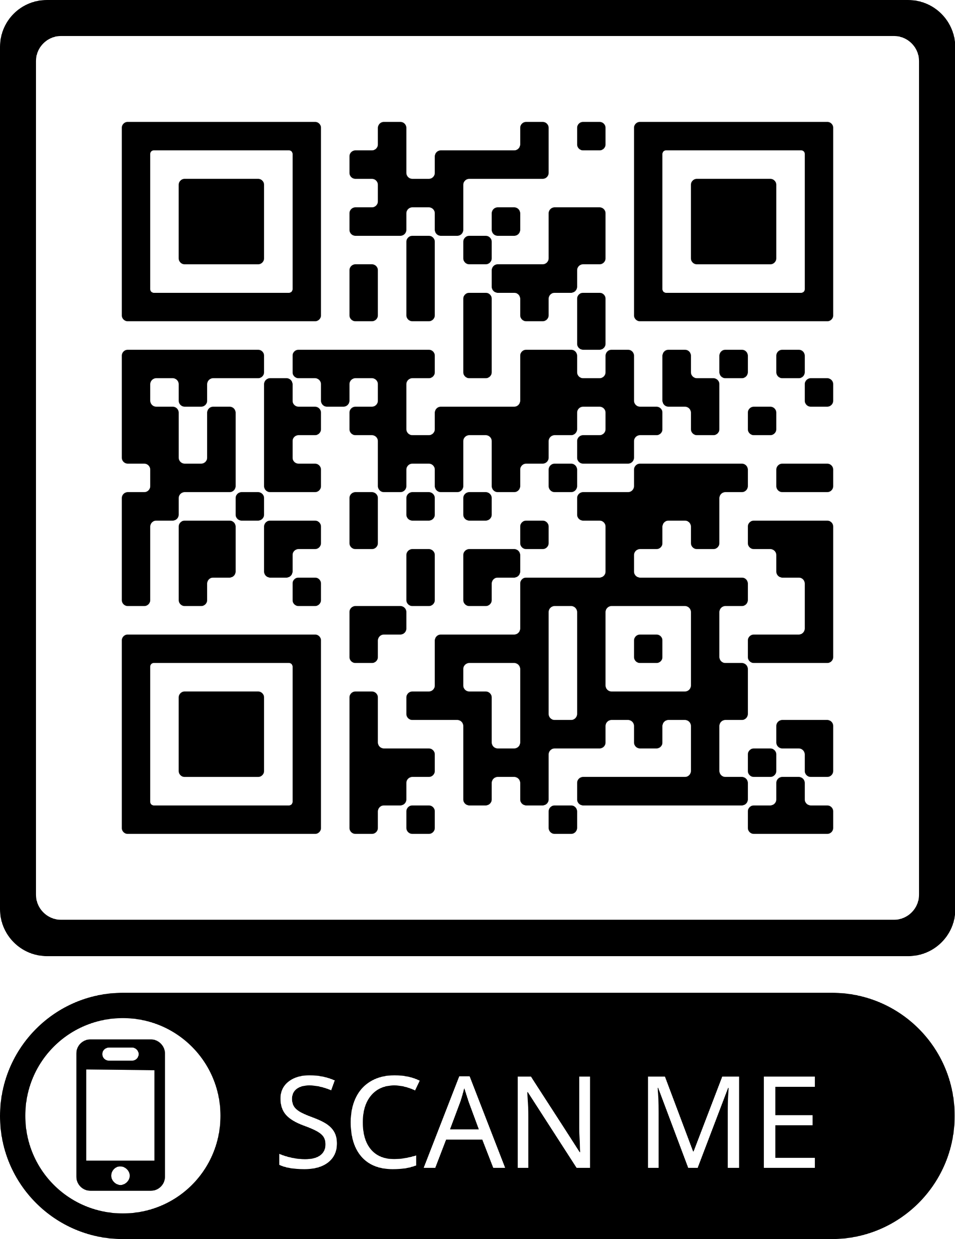
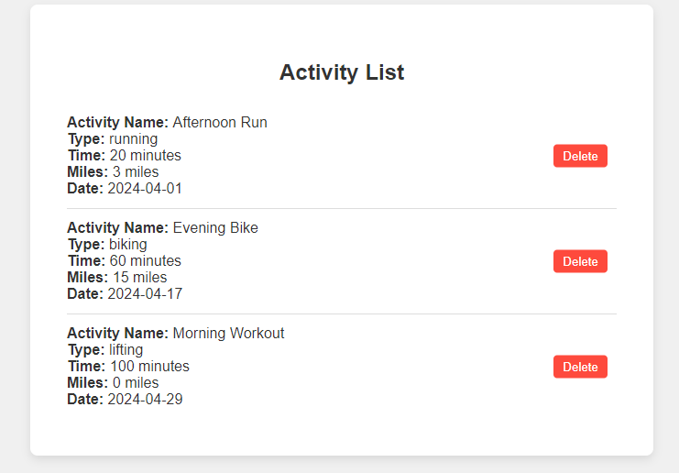
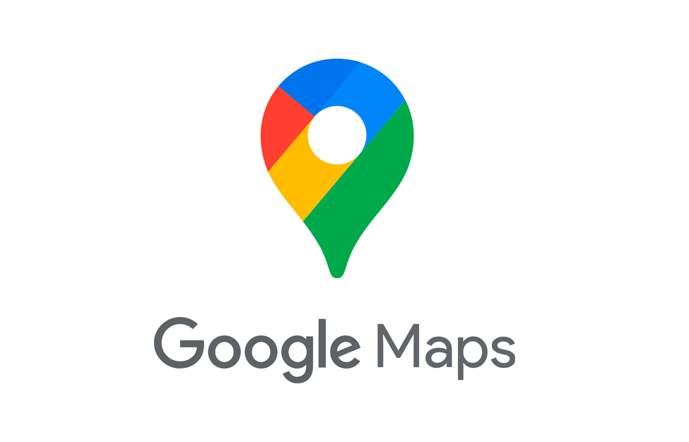
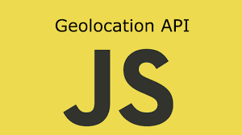

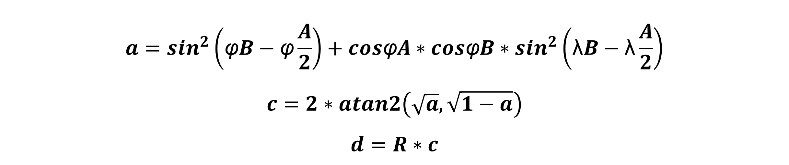
GitFitness – A Fitness Tracker Web Application
Noah Greski, Frederich De Koker, Prof. Chaudhari
GitFitness Introduction
Distance Tracking
Haversine Formula and Geolocation
GitFitness Mobile Distance Tracker
As athletes at Siena College, we wanted a place to track our workouts and set our goals. GitFitness does just that. GitFitness allows users to create a profile upload activities, set goals and view their overall stats and progress.
We used a JavaScript GeoLocation APIs, to track the user’s location and start a timer. - Browser API that allows web apps to get user’s location.
-This allows the user to walk, run or bike and track the distance and time directly in our website.
The Haversine formula determines the distance between two points on a sphere given their latitudes and longitudes.
Haversine Formula:
To calculate the distance, an event handler is set up with the Geolocation’s watchPosition() method, which triggers upon any change in the device's location, and these changes are then inputted into the Haversine Formula to determine the distance traveled. We assume that the earth is a sphere!
$$a=\sin^{2}\left(\text{φ}B−\text{φ}\frac{A}{2}\right)+cos\text{φ}A∗cos\text{φ}B∗\sin^{2}\left(\text{λ}B−\text{λ}\frac{A}{2}\right)$$
$$c=2∗atan2\left(\sqrt{a}, \sqrt{1−a}\right)$$
$$d=R∗c$$
TRY NOW AT THIS LINK:
https://ngreski.github.io/fitness-app/track
GitFitness Architecture
Three Tier architecture
GitFitness uses a three-tier web application architecture. The presentation tier (frontend) uses HTML, CSS and JavaScript. This displays information for users and collects user inputs. The second tier is the application tier (backend). This tier uses JavaScript and its purpose is to process user inputs from the frontend and interact with the database. The third tier is the data tier (database). We used the SQLite database for this tier. The database’s purpose is to store activity information, profile information, etc.
Distance Tracking
Google Maps API
Conclusion & References
GitFitness has various features to allow users to track their fitness goals. However, there are several ways that we can improve our website. One direction we would like to go into would be connecting with other websites. For example, allowing the transfer of activities from a website like Strava or Garmin to our website. This way users can sync all their activities on all the websites they would like to use!
References:
Google. Geolocation API overview. https://developers.google.com/maps/documentation/geolocation/overvi ew
MozDevNet. Geolocation: Watchposition() method - web apis: MDN. MDN Web Docs. https://developer.mozilla.org/en- US/docs/Web/API/Geolocation/watchPosition
Rossiter, H. (2020, May 7). Calculating distance between geographic coordinates with JavaScript. Medium. https://henry- rossiter.medium.com/calculating-distance-between-geographic- coordinates-with-javascript-5f3097b61898
Wikimedia Foundation. (2024, April 9). Haversine formula. Wikipedia. https://en.wikipedia.org/wiki/Haversine_formula
-Google Maps Geolocation API is one way that a user’s location can be tracked through a mobile device. The SDK allows precise distance computation. It supports devices’ latitude and longitude is determined through various signals like Wi-Fi, GPS, and cell towers, but this is dependent on google, requires the installation of an SDK and has privacy concerns. -In the case of GitFitness we leverage the native GeoLocation APIs that are provided by modern browsers. The user does not need to install yet another app and can access precise location information enabled by their mobile phone’s hardware.
Acknowledgements: This material is based upon work partially supported by the Google Cloud Education Credits program

